Slide 1
Patterns in the Industry

Slide 2
Why you should have been paying attention!

Slide 3
CONTEXT

Slide 4


Slide 5


Slide 6
Let’s talk about patterns...

Slide 7
Increase cohesion

Slide 8
Decrease coupling

Slide 9
Principles and You

Slide 10
Separate your concerns

Slide 11
Don’t repeat yourself

Slide 12
Keep things simple

Slide 13
Single responsibility

Slide 14
Watch for these:
Separation of concerns
Don’t repeat yourself
Keep it simple
Single responsibility
Decreased coupling
Increased cohesion

Slide 15
Let’s begin!

Slide 16
Observer Pattern

Slide 17
Problem
An object depends on another for an update

Slide 18
But
Instructions can be blocked for a long time, waiting (Commonly network calls or read/writes from disk)

Slide 19
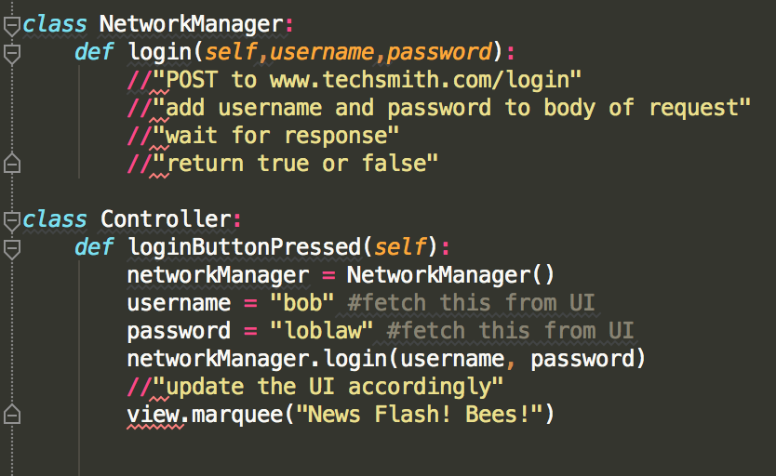

Slide 20
Strategy
Observing object can continue executing
Observed object finishes processing
Observing object is alerted

Slide 21
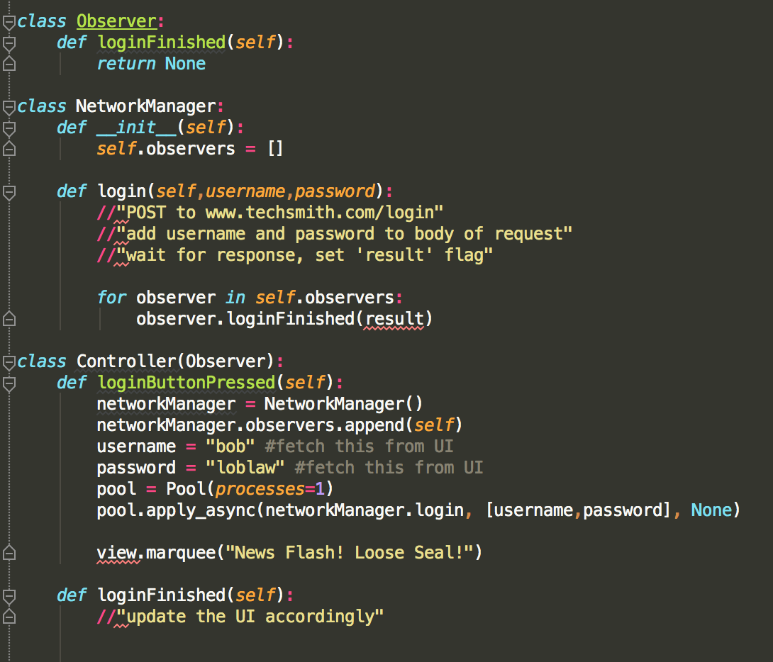

Slide 22
Observer Summary
Strong one-to-many relationship
Key for asynchronous tasks

Slide 23
Let’s check it out eh?

Slide 24
Strategy Pattern

Slide 25
The pattern

Slide 26
Problem
One object behaves differently depending on its context

Slide 27
Example: Scrolling Capture
Some content is too large to fit on the screen…
Capture all of the content as one contiguous image…
Provide a single user experience

Slide 28
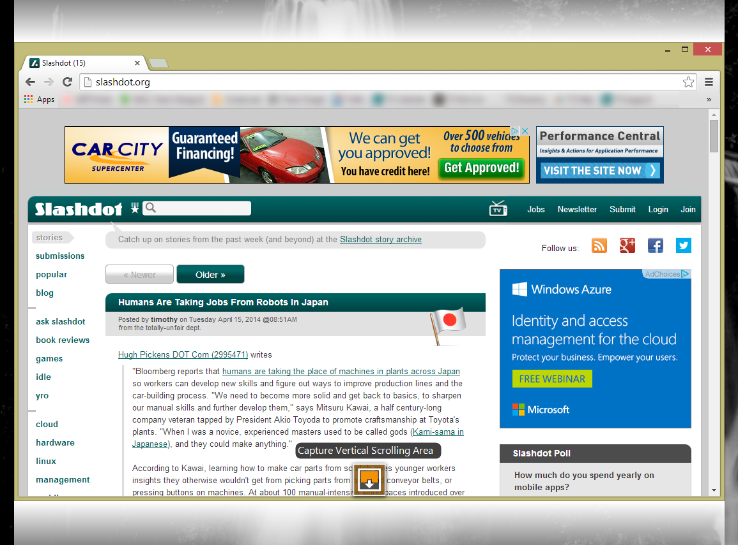

Slide 29
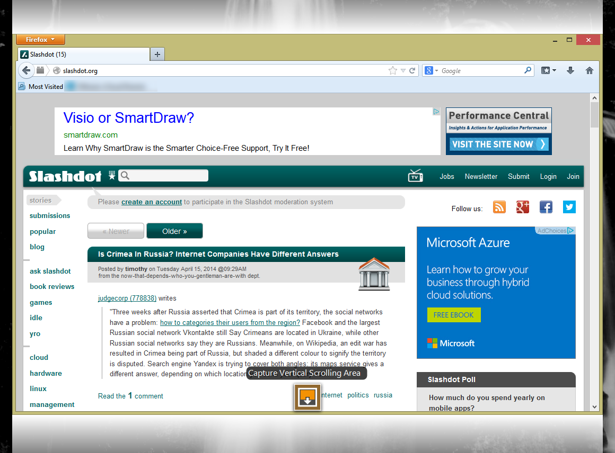

Slide 30
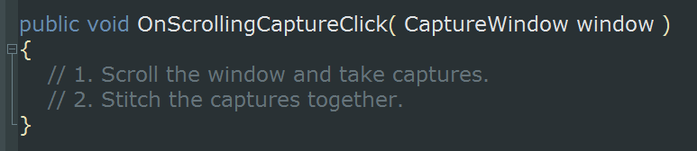
The Goal

Slide 31
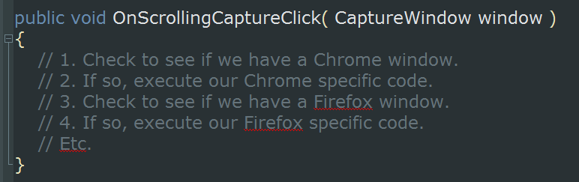
Naive Approach

Slide 32
Why is this naive? Well...

Slide 33
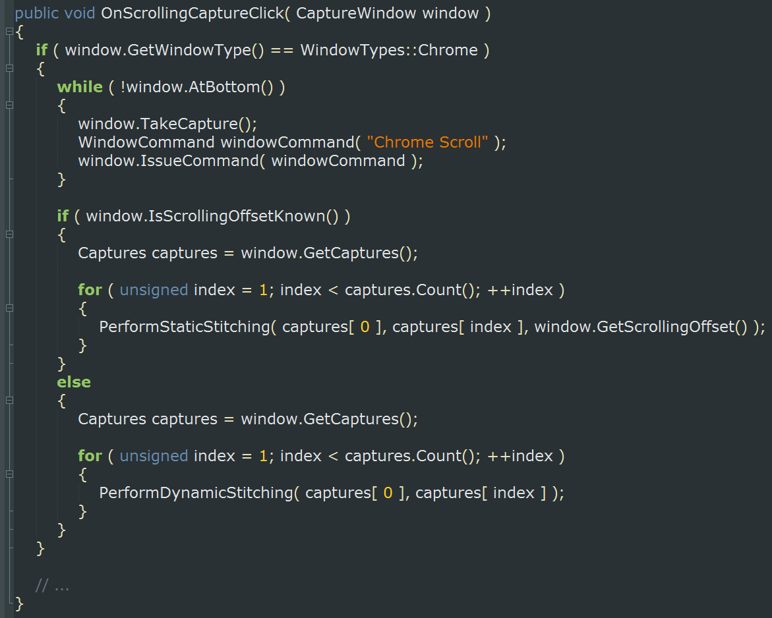

Slide 34
The function has too many responsibilities

Slide 35
It’s difficult to understand

Slide 36
It’s difficult to add functionality

Slide 37
Code complexity increases exponentially

Slide 38
Code complexity increases exponentially

Slide 39
Need proof?!

Slide 40
Let’s add another window type...

Slide 41
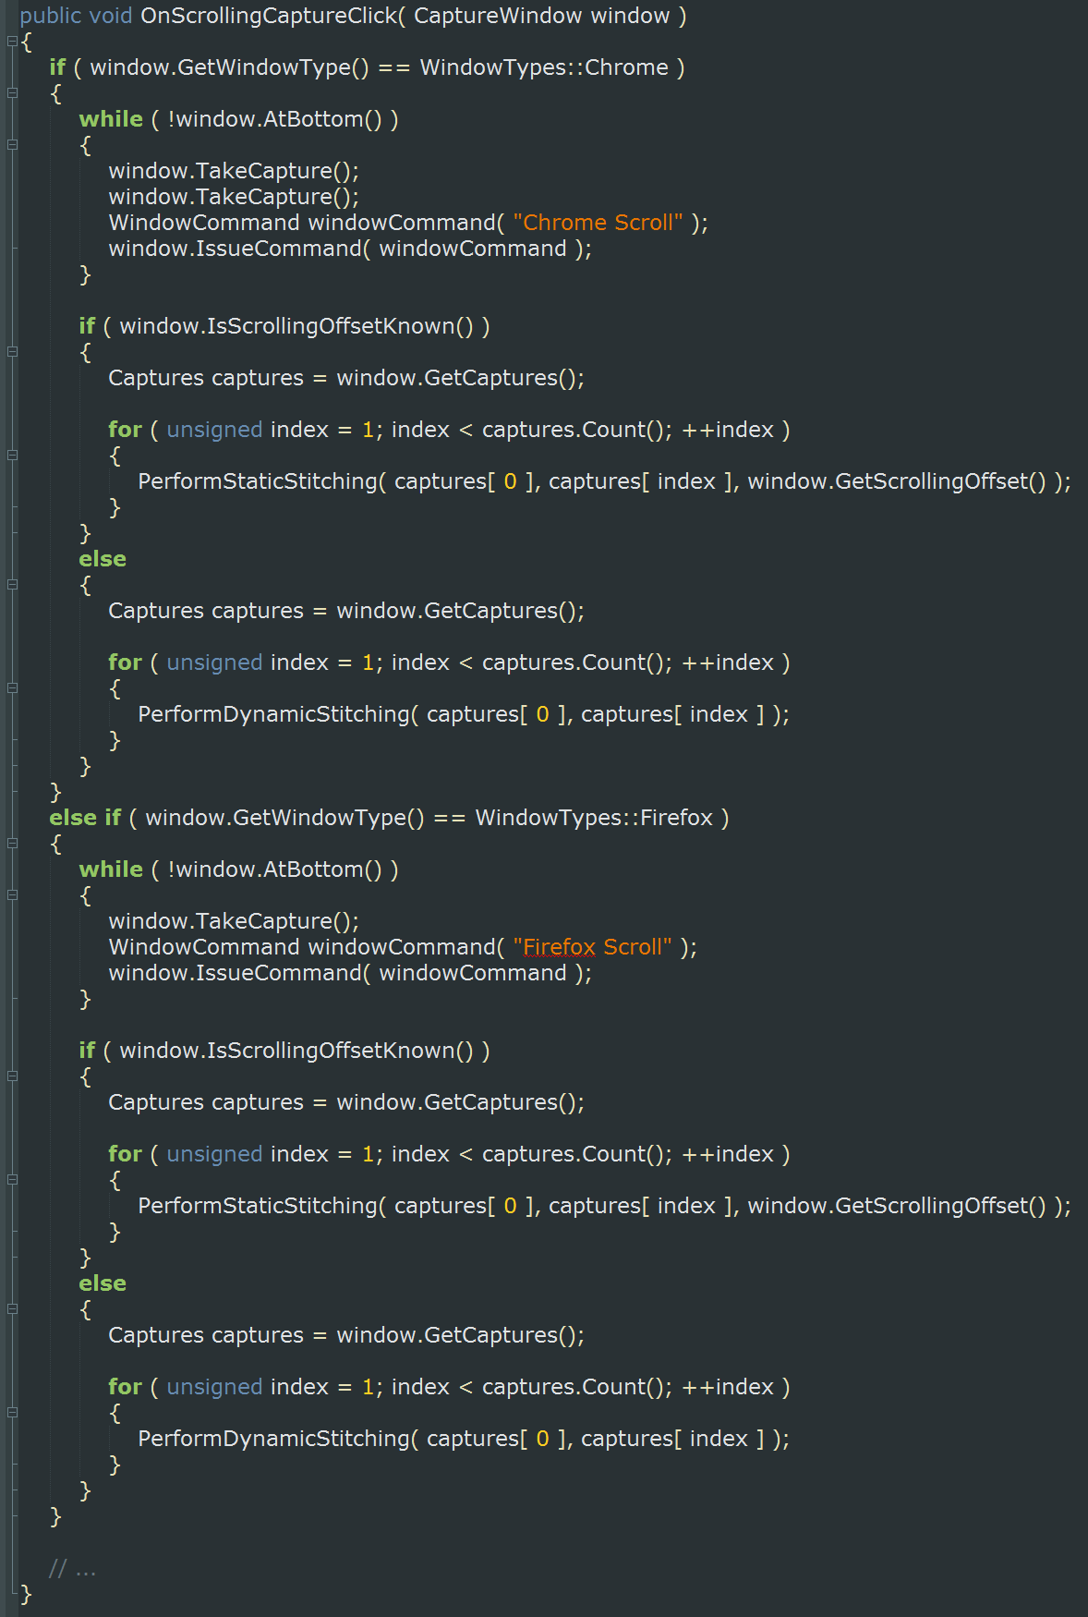

Slide 42
Food for Thought
What about another version of the same browser?
What about a new stitching method?
Think about how confusing and error prone the code becomes

Slide 43
How about a better approach?

Slide 44
Strategy
Let the object’s behavior be decided at runtime
Define a family of algorithms
Let the algorithm vary independently from objects that use it

Slide 45
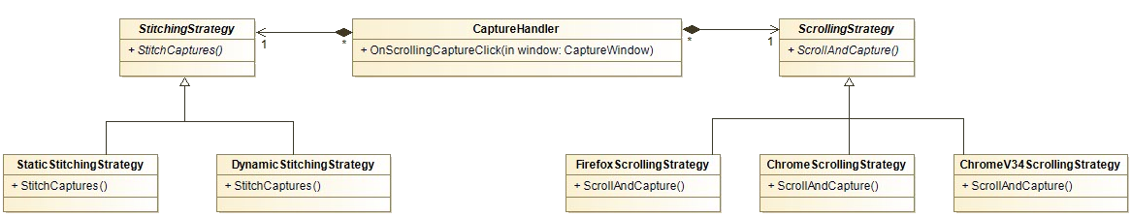

Slide 46
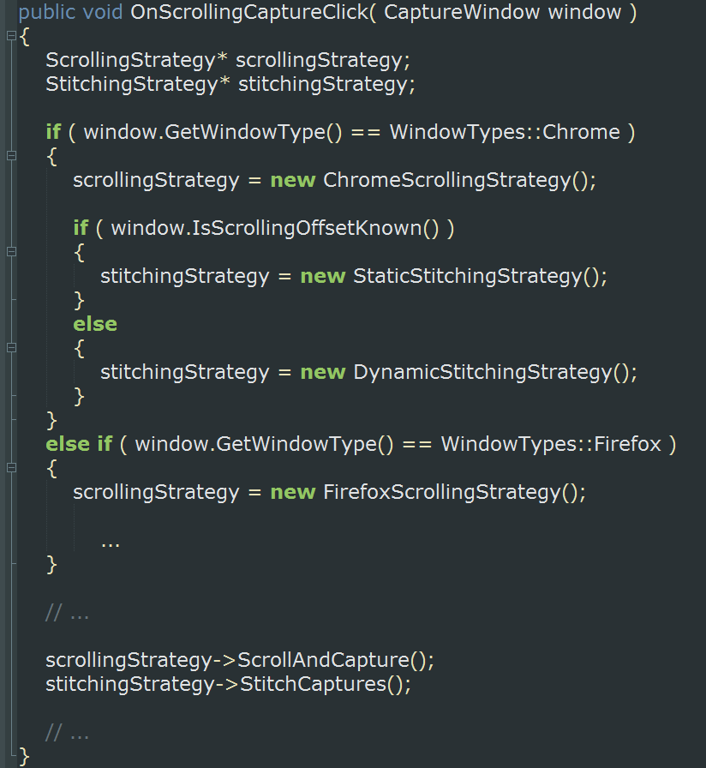

Slide 47
Let’s add another window type...

Slide 48
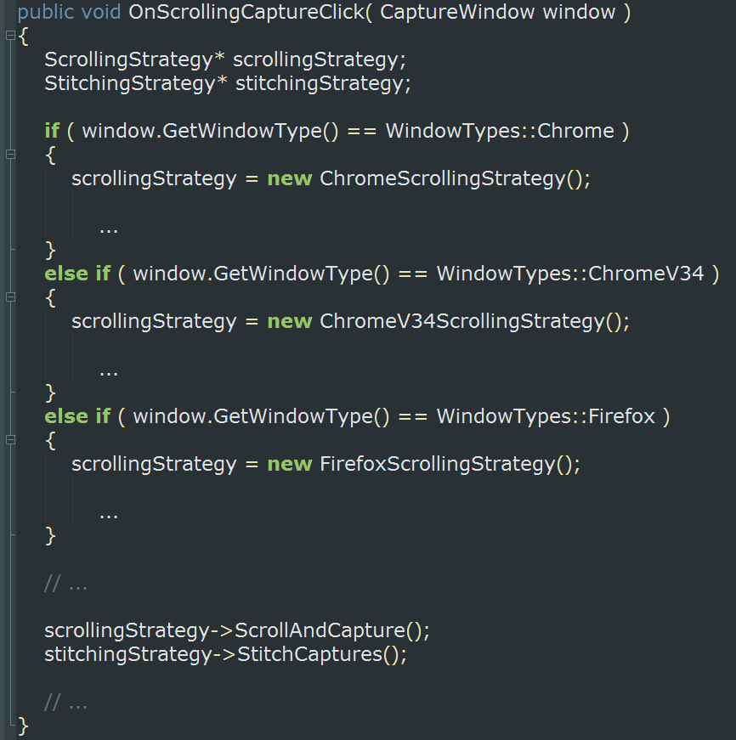

Slide 49
Why is this better?

Slide 50
We can easily add new strategies

Slide 51
We’ve increased cohesion

Slide 52
We’ve separated concerns

Slide 53
Factory Method

Slide 54
Problem
So many strategies, so little time

Slide 55
Continuing the example...

Slide 57
Strategy (not the pattern…)
Define and interface for creating an object
Let the implementing class decide which class to instantiate
Defer instantiation to subclasses

Slide 58
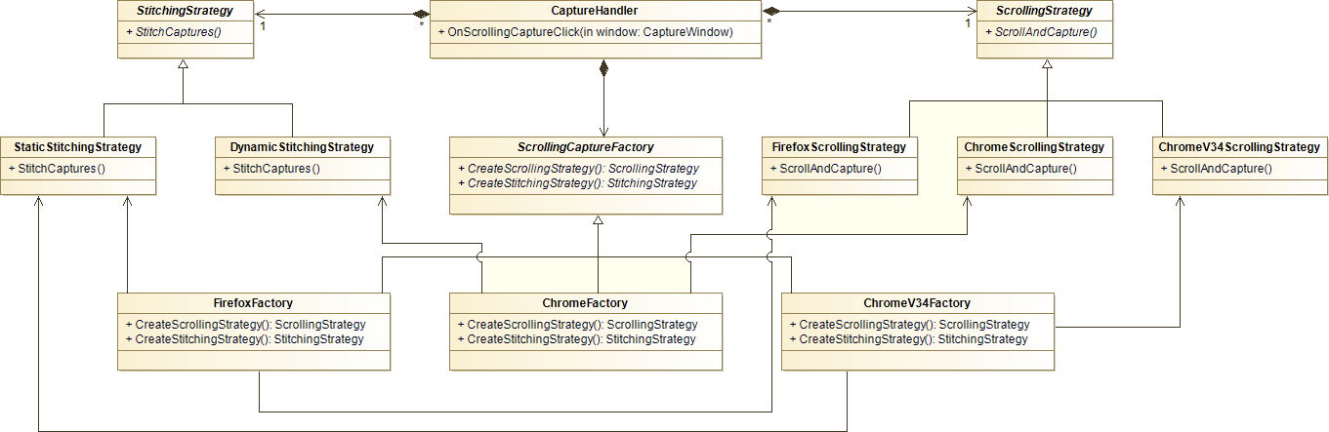

Slide 59
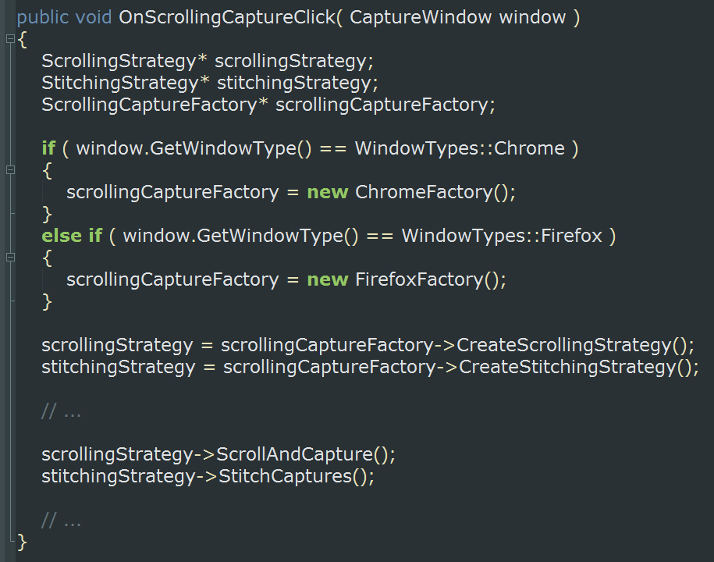

Slide 60
Let’s add another window type...

Slide 61
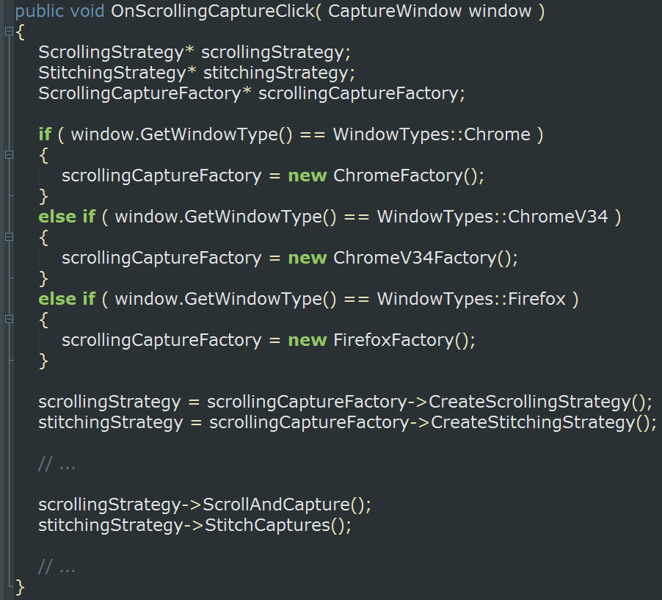

Slide 62
Why is this even better?

Slide 63
We’re further separating concerns

Slide 64
We’re not repeating ourselves

Slide 65
We’re keeping it simple

Slide 66
We’ve further increased cohesion

Slide 67
Questions?!

Slide 68
Common Pitfalls
You’re doin’ it wrong!

Slide 69
The Silver Bullet
The belief that your favorite solution
solves all the things

Slide 70
Gold Plating
When you continue to “improve” a project
way past the point of adding actual value

Slide 71
Scope Creep
Adding new requirements to a project after work
on the project is already underway

Slide 72
Premature Optimization
Trying to solve perceived efficiency problems
before you have a working solution

Slide 73
Magic Numbers and Strings
Including unexplained numbers and strings
in algorithms

Slide 74
Sunk Cost Fallacy
Continuing to maintain undesired code because
removing it is too expensive or risky (technical debt)

Slide 75
Forced Abstraction
Making code generic where it doesn’t make sense

Slide 76
Blind Trust
Not verifying the result of a code change
because you think it’s trivial

Slide 77
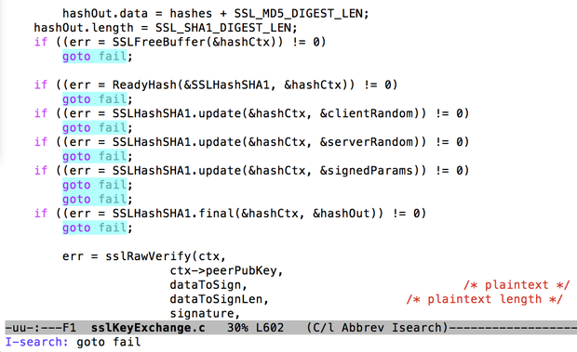

Slide 78
Questions?!

Slide 79

2walls

Slide 80


Slide 81


Slide 82


Slide 83


Slide 84


Slide 85
Thanks!

